Slide 2
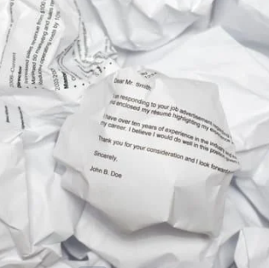
What is a cover letter?
It is usually the first piece of your application that is read.
A cover letter introduces you and your resume to potential employers or organizations you seek to join.
You never get a second chance to make a first impression.

Slide 3
Purpose of a Cover Letter
A compelling cover letter answers, “Why you?” and “Why them?”
Why You: Focus their attention on your most relevant compelling qualifications
Why them: Include a sentence to a paragraph on why you want t work at this company.
IT IS NOT A RESTATEMENT OF YOUR RESUME

Slide 4
Making a Connection
Companies appreciate applicants who can relate to their mission, culture, and employees.
How do you make a connection?
Share a story that demonstrates how you connect with their mission, culture, or brand
Explain how they are special amongst their competitors
Reveal why you value them and the work they do

Slide 5
Business Format
Font – Calibri, Arial, & Times New Roman
Single space
Leave a space between the paragraphs, closing, and before and after contact information.
Always align the letter left

Slide 6
Heading
The heading on your cover letter should match your resume
Includes the following
Name (BIG & BOLD)
Address
Phone number
Email

Slide 7
Inside Address
This is who you are sending your cover letter to
Unless the job posting specifies “no phone calls” and the name is not given in the job posting find out the individual who will be receiving your letter.
Make sure you spell the name properly and get the proper abbreviation (Mr. / Ms. / Mrs. / Dr.)
Information
Employer’s Name
Job Title
Business Name
Street Address
City, State, Zip Code

Slide 8
First Paragraph
Get the reader's attention!
Discuss the position you are applying for
Highlight the main points you will be focusing on in the letter

Slide 9
Body Paragraph
Emphasize strongest qualification or strengths
Show how the qualifications will benefit the company
Provide examples of previous achievements / experiences
Point out any related experience you have

Slide 10
Closing Paragraph
Remind the reader why you are a great candidate
Express interest in an interview
Be genuine and thank them for their time.
Complimentary close (Sincerely)
Signature

Slide 11
Helpful Hints
Do not overuse the word “I”
Use action verbs when describing your experiences
Get to the point! Hiring Managers don’t have time to read length letter
Make sure your letter is PERFECT!
Spelling, punctuation, and grammar count!!!
PROOFREAD, PROOFREAD, PROOFREAD
Go over it with a fine-tooth comb
NEVER submit a cover letter without having someone proofread it
Use only one page

Slide 12
Helpful Hints
Focus on the specific skills and interests you possess that you can offer the employer
Concentrate on skills which match the advertisement
Stress what you can do for the company, not what the company can do for you!
SELL YOURSELF!
Don’t mention salary expectations

Slide 13
Before Submitting
Is it clear?
Does it state exactly what I want it to state?
Is it concise?
Is it well organized?
Am I projecting the contribution I can make to the company?
Have I stressed areas in my experience and/or education that are relevant?
Before submitting, make sure you can answer “YES” to all these questions

Slide 14
TERMS OF USE
•All slides in this product are copyrighted. You may not create anything to sell, or share based on this packet.
•This packet is for one teacher use only. Do not share with colleagues. If they like the product, please send them to my TPT store. TPT is about educators supporting educators.
•You are permitted to share the cover image of this product on your blog or via social media if you link back to my blog post showcasing the product or the product link on TPT

